Slide 1
COVID-19 VISUALIZATION USING MATLAB
Submitted in the partial fulfillment for the award of the degree of
BACHELOR OF ENGINEERING
IN
BIG DATA ANALYTICS
Submitted by:
YASH SRIVASTAVA-20BCS4443
KHWAHISH AGARWAL-20BCS4447
SWETA NEGI-20BCS4422
YOGESH GEHLOT-20BCS4454
Under the Supervision of:
PUNEET KAUR BHATIA
Department of AIT-CSE
DISCOVER . LEARN . EMPOWER

Slide 2
Outline
Introduction to Project
Problem Formulation
Objectives of the work
Methodology used
Results and Outputs
Conclusion
Future Scope
References

Slide 3
Introduction to Project
Problem Definition
The goal of our project is to create a MATLAB program that processes and visualizes COVID-19 pandemic data.
The COVID-19 outbreak, which first emerged in China, has spread worldwide. On March 11, 2020, the World Health Organization (WHO) declared COVID-19 as a pandemic.
The disease has disrupted global trade, employment, and travel, and many governments had to take strict measures to control the spread of the virus and minimize the burden of morbidity and mortality so that health care systems remain functional.
In many countries around the world, citizens have been recommended to stay at home and practice social distancing for as long as possible as a primary measure of preventing the spread of COVID-19.

Slide 4
Introduction to Project
Problem Definition
Although apps are successfully used for managing chronic diseases, the ongoing COVID-19 pandemic has pushed the need for app solutions at the forefront to reduce the risk of cross-contamination caused by close contact.
This technology has been leveraged in several ways to control the spread of COVID-19. Apps are accessible, acceptable, and easily adopted, and could support social distancing efforts.
As such, they have been widely developed and implemented during the previous months to “flatten the curve” of the increasing number of COVID-19 cases, providing knowledge and information to civilians while attempting to relieve the pressure from health care systems.

Slide 5
Problem Formulation
This project is a App bases Application using the MATLAB concept of designing a application. This application helps the people to visualize the proper graph or trend of covid 19 to the needy ones. The app will act as an intermediate between government and people. There are three parts:
COUNTRY CLASS: - In this class we are creating function and object to call and fetch data from data.mat dataset to show all the country names in our app and we can easily choose the country to see covid cases of that country .
STATE CLASS: - - In this class we are creating function and object to call and fetch data from data.mat dataset to show all the states names in our app and we can easily choose the country and state to see covid cases of that state in chosen country.
APP: - After opening the App first we have an option to choose the country and states
Then we have to select the option of cases and death and we can chose both to watch cases and death trend at a same time then we have an option to chose the data type like cumulative or daily type then we have a slider for average of 15 days data.
Activity program for country | Activity program for state | Activity diagram for App

Slide 6
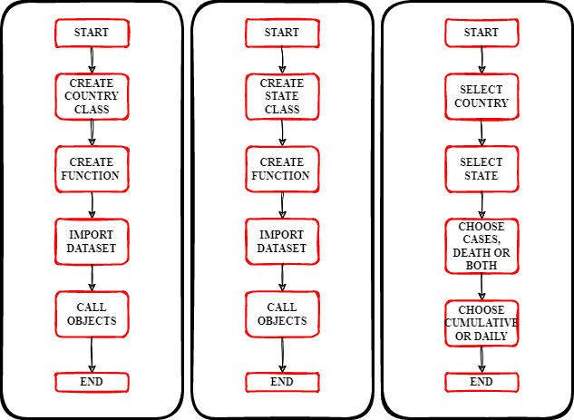
Problem Formulation
Activity program for country | Activity program for state | Activity diagram for App

Slide 7
Objectives of the Work
During the current coronavirus pandemic, monitoring the evolution of COVID-19 cases is of utmost importance for the authorities to make informed policy decisions (e.g., lock-downs), and to raise awareness in the general public for taking appropriate public health measures.
At the time of the pandemic outbreak, a lack of laboratory tests, materials, and human resources implied that the evolution of officially confirmed cases did not represent the total number of cases.
Even now, there are significant differences across countries in terms of the availability of tests. For this reason, given the rapid progression of the pandemic, in some cases health authorities are forced to make important decisions based on sub-optimal data.
For this reason, alternatives to testing that can be rapidly deployed are likely to help authorities, as well as the general population, to better understand the progress of a), particularly at its early stages or in low-income countries, where massive testing is unfeasible.
To this end, we have created a system, named COVID-19-DATA-ANALYSIS-AND-VISUALIZATION to estimate the number of COVID-19 cases based on crowd-sourced open anonymous surveys.

Slide 8
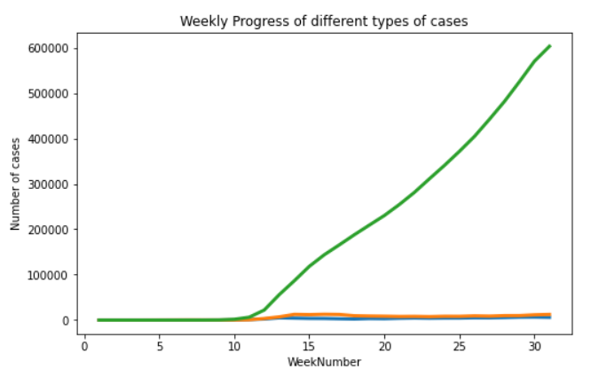
Methodology used
As the name itself means ‘a system of methods used in a particular area of study or activity’. In this section we are going to give a detailed explanation of workflow of our application and methods involved in it sequence diagram.
Type of Research done:
On March 11, 2020, the World Health Organization (WHO) declared the novel coronavirus (Covid19) outbreak as a global pandemic. In this paper, a time series analysis to predict the number of deaths in the United States starting from August 1st — August 21st and August 1st — November 1st is modelled and studied. The time series model that was selected to make the prediction.

Slide 9
Methodology used
By analysing the current situation and scenario we came up with this project idea.
Workflow of Our Application:
We are designing a app which enables users to easily watch the trends of covid 19 cases and death and using Time Series Analysis for prediction of upcoming covid waves.
Let’s see how this all works-
Application: -
1)Created a country class to extract the data of different country of covid 19 cases and deaths.
2)Created a state class to extract the data of different states of different countries to find and analysis the cases of covid 19 and prevent any future issue related covid in that region.
3)Created the app to visualized the data of different country and states in one place and have to many another features like we can see the trend of cases , deaths and both of particular country and sates at same time then we have a another option of cases like cumulative or daily types of cases then we can also see the data in average using the slider.

Slide 10
Methodology used
Working of App
Once you load it, you will get a single variable called covid data that is a large cell array.
Each data cell for a given country and date contains a 2-element vector of doubles:the first element is the cumulative case count, while the second is the cumulative number of deaths.
Our program converts this data into a set of objects: one object per country and state. States should be contained by their countries.
Countries could be stored in a vector of country objects in the app itself. Another way is to create an instance of the same class we use for countries and states, call it global, and have it store all the countries.
The app would then contain the single global object as a property.
This option would create a 3-level hierarchy: the global object stores data for the entire world and a vector of country objects, while the objects of countries that have states in the database would store their corresponding states.
Again, we can use the same class definition for all three kinds of objects because they store essentially the same kind of data.

Slide 11
Methodology used
Time Series Analysis: -
Time series analysis (TSA) is a statistical technique that consists of data points listed in time order. The x axis is made up of equally spaced points in time and the y axis contains the outcome values that are going to be projected from our model based on previous observed values. This technique is suitable for research questions such as forecasting future sales. The reason why time series analysis exists, is since the outcome variable in our model is dependent on one single explanatory variable only: time.
Suppose you run a shoe store and have the data available that tells you how many shoes you have sold in the past years. Given the data available, time series analysis would be applicable if you would like to predict how many shoes your store will sell in the future. In this case, the outcome variable would be the number of shoes sold and the one and only explanatory variable would be time.
Other forecasting algorithms such as linear regression or logistic regression use one or more explanatory variables. Further there is a difference when it comes to the assumptions when comparing linear regression, logistic regression, and the time series technique ARIMA.

Slide 12
Methodology used
In Linear Regression the following assumptions have to be met:
Independence of observations.
Homoscedasticity of errors (equal variance).
A linear relationship.
Errors are normally distributed.
In Logistic Regression the following assumptions have to be met:
Dependent variable has to binary.
Independence of observations.
Linearity in the logit for continuous variables.
Lack of influential outliers
Absence of multicollinearity

Slide 13
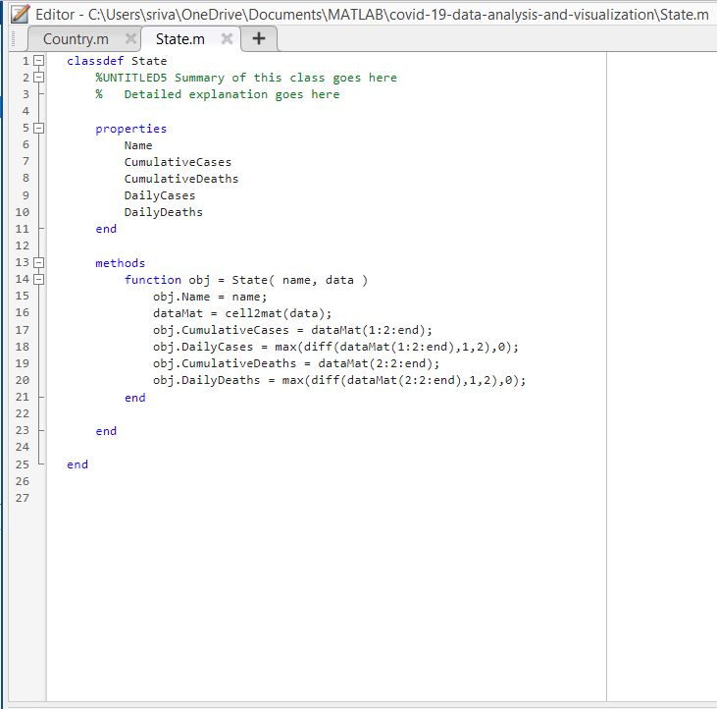
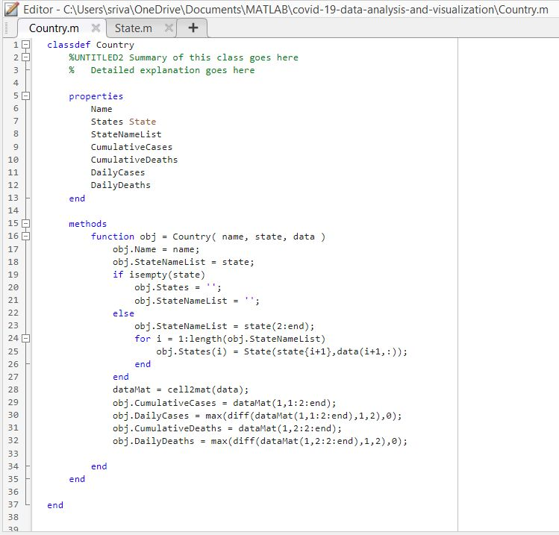
Results and Outputs
CODE FOR MATLAB

Slide 14
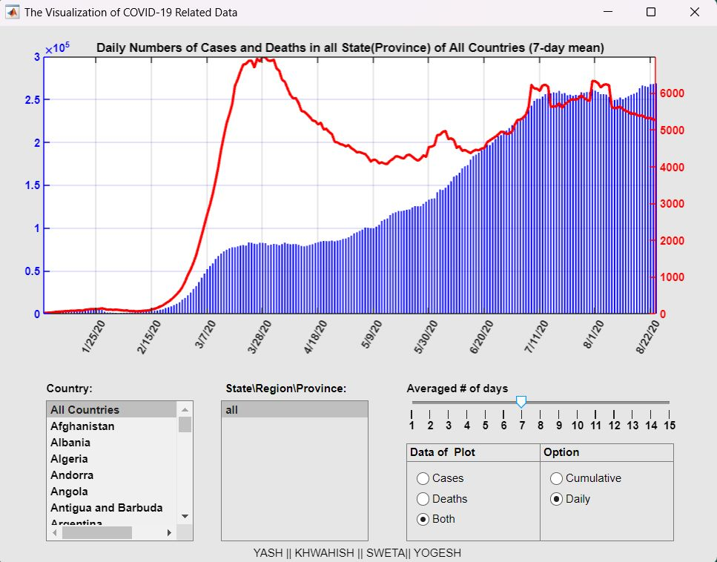
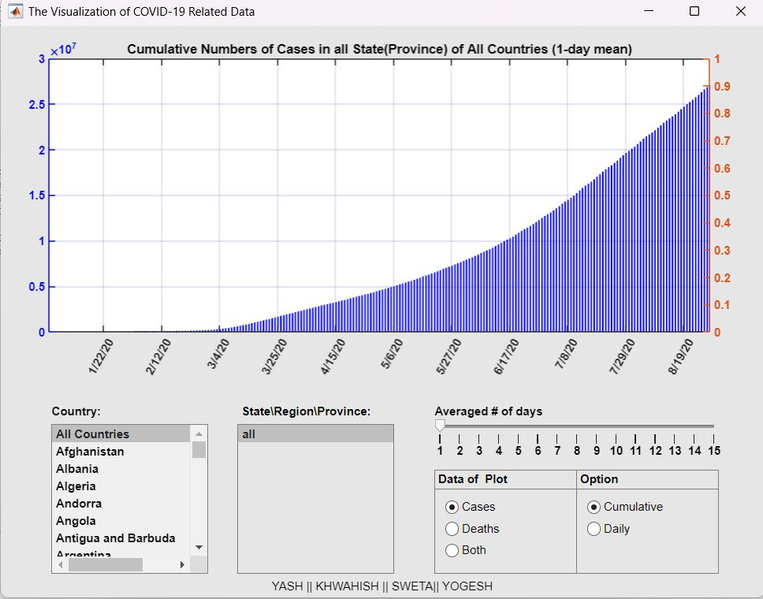
Results and Outputs
MATLAB VISUALIZATION

Slide 15
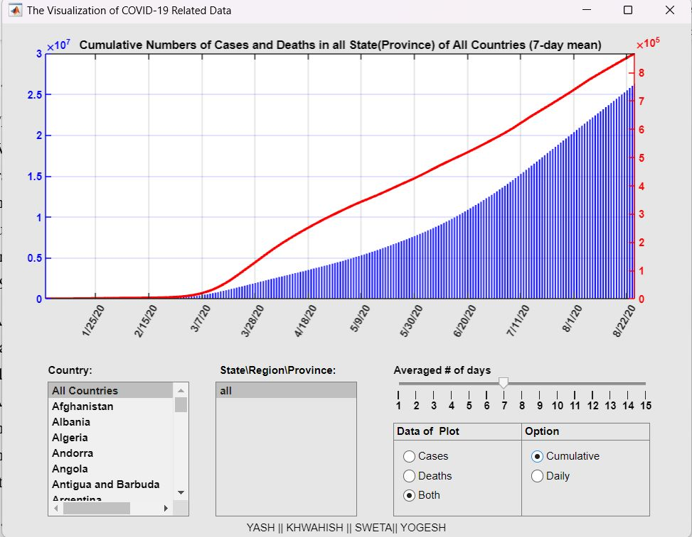
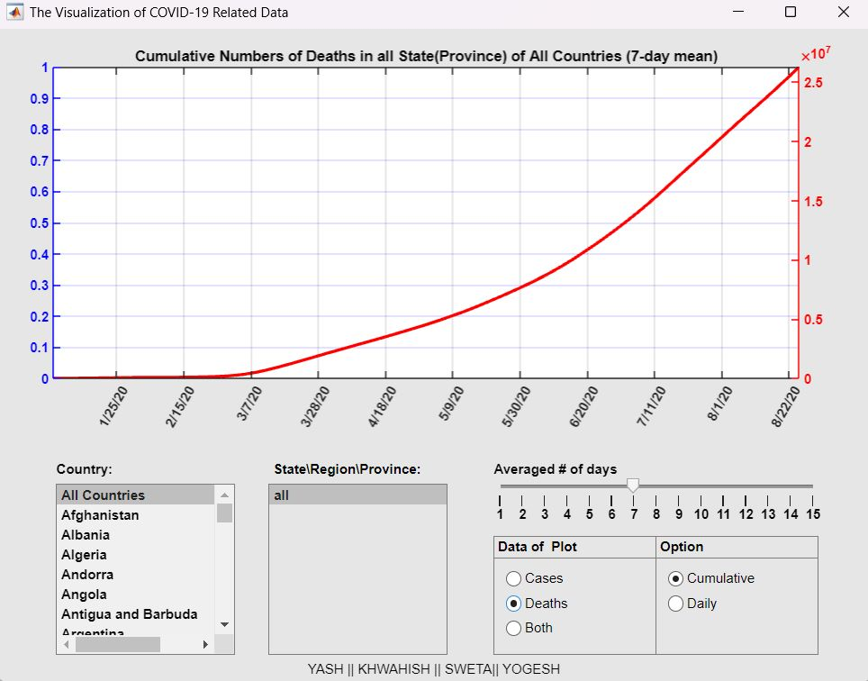
Results and Outputs
MATLAB VISUALIZATION

Slide 16
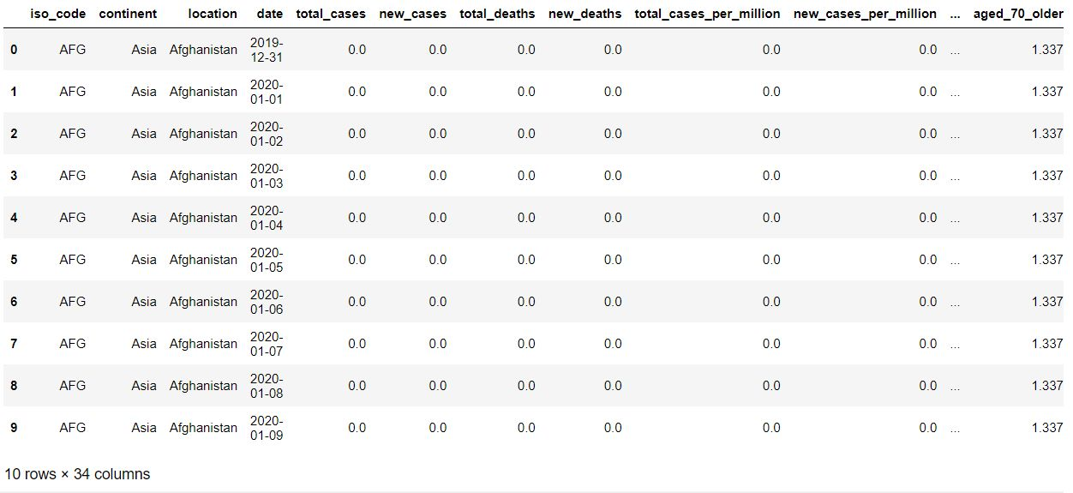
Results and Outputs

Slide 17
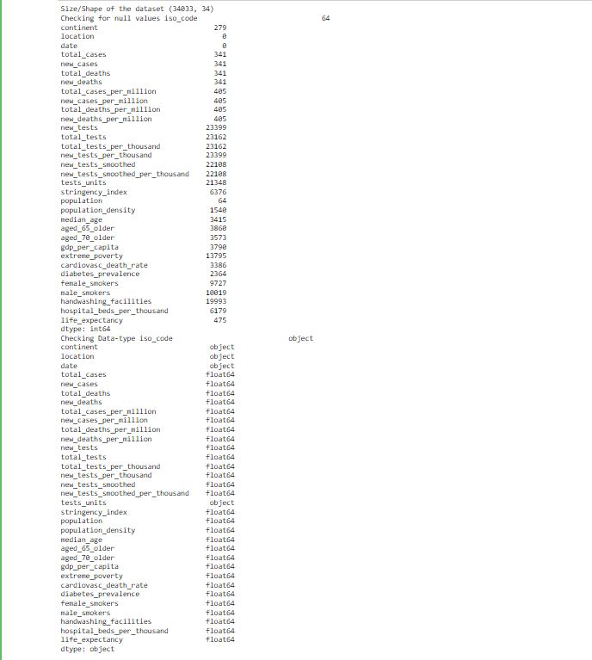
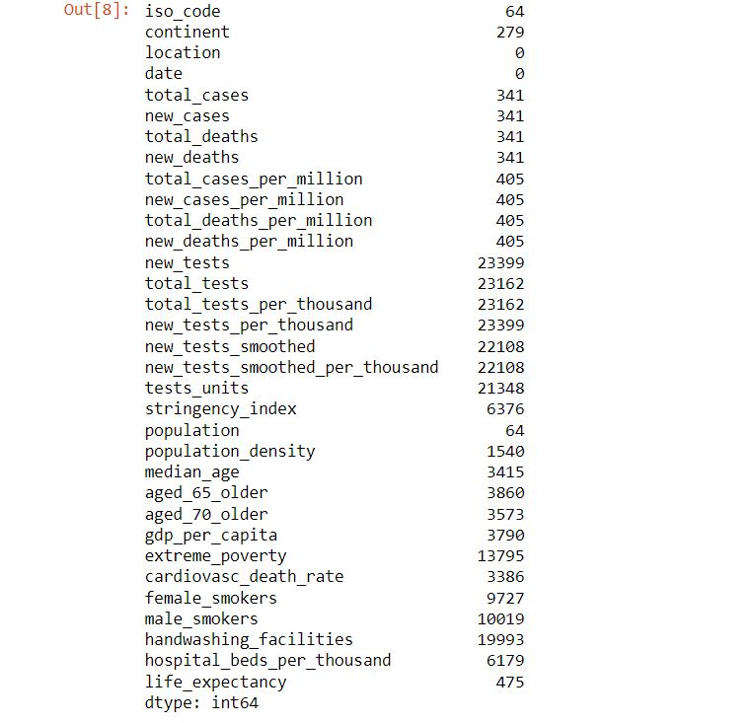
Results and Outputs

Slide 18
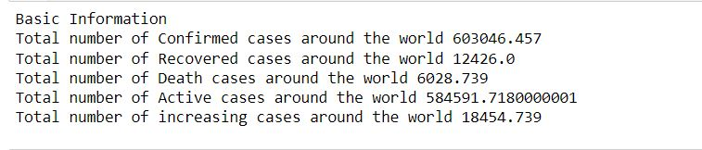
Results and Outputs

Slide 19
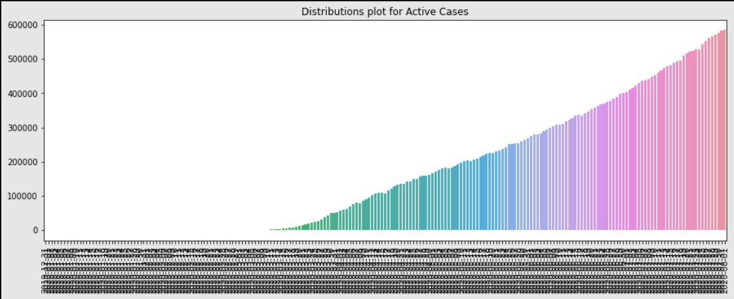
Results and Outputs

Slide 20
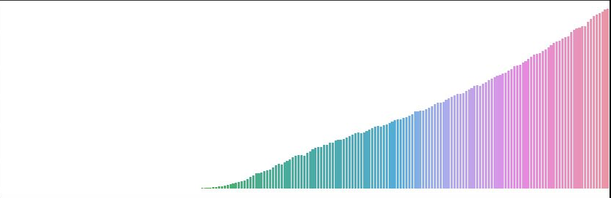
Results and Outputs

Slide 21
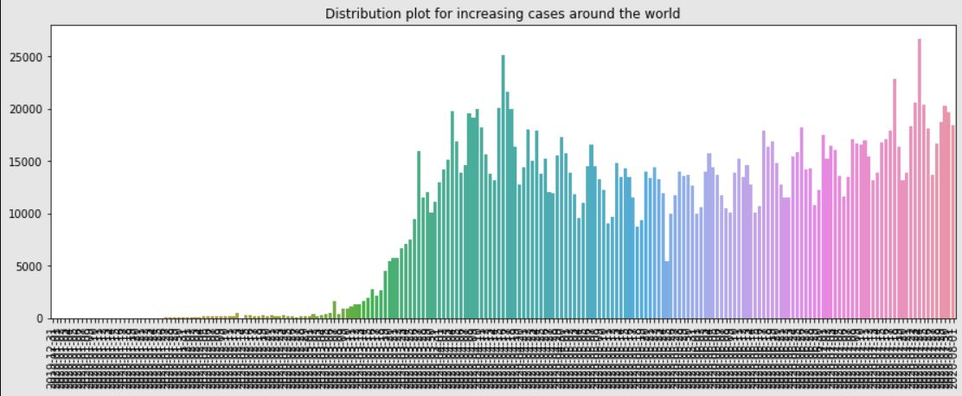
Results and Outputs

Slide 22
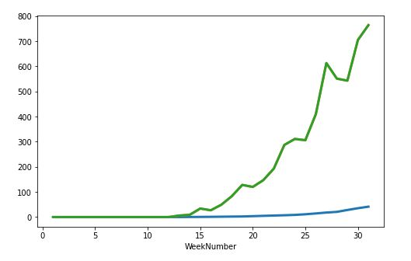
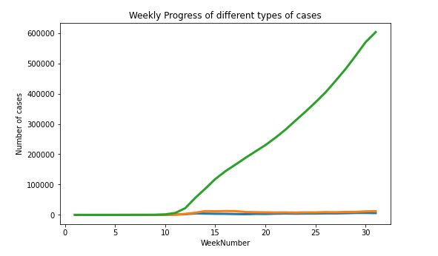
Results and Outputs

Slide 23
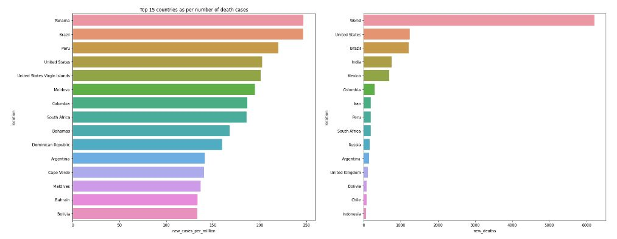
Results and Outputs

Slide 24
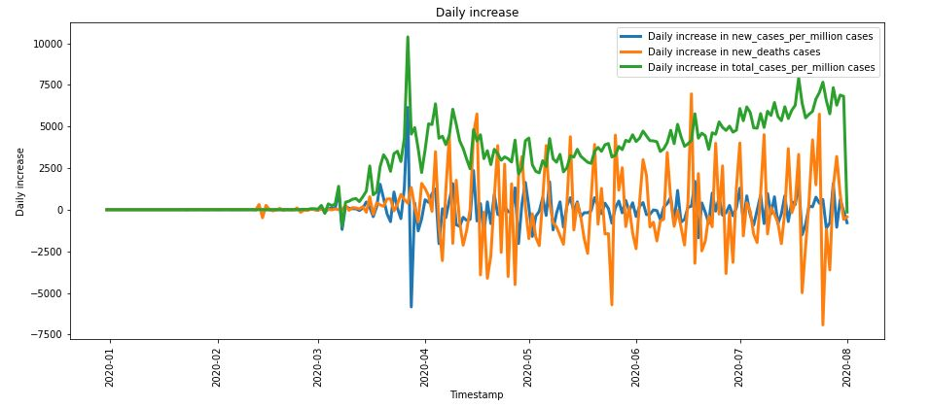
Results and Outputs

Slide 25
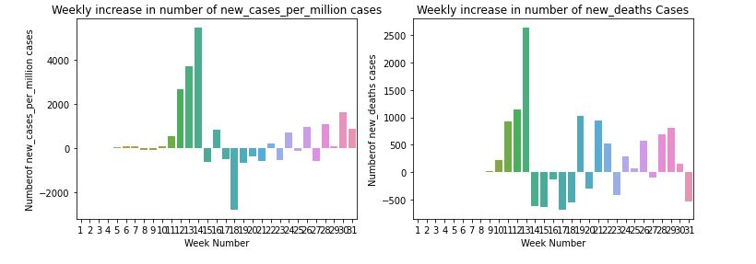
Results and Outputs

Slide 26
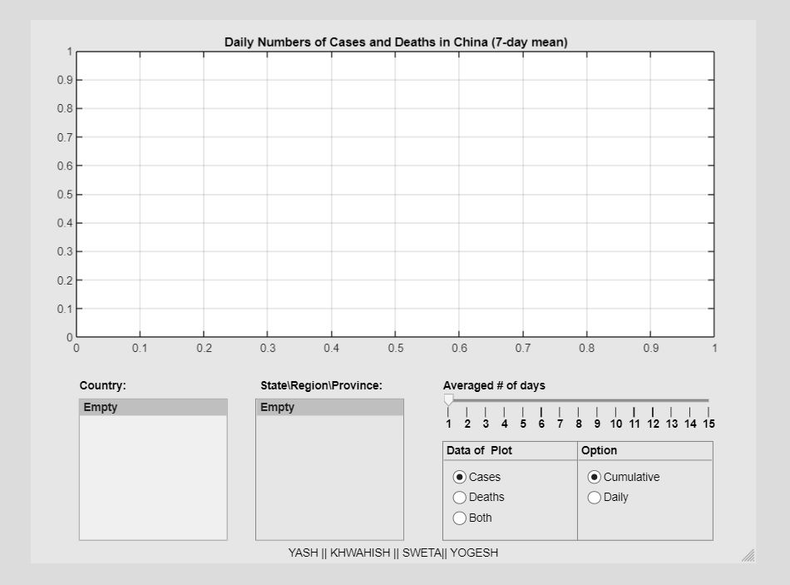
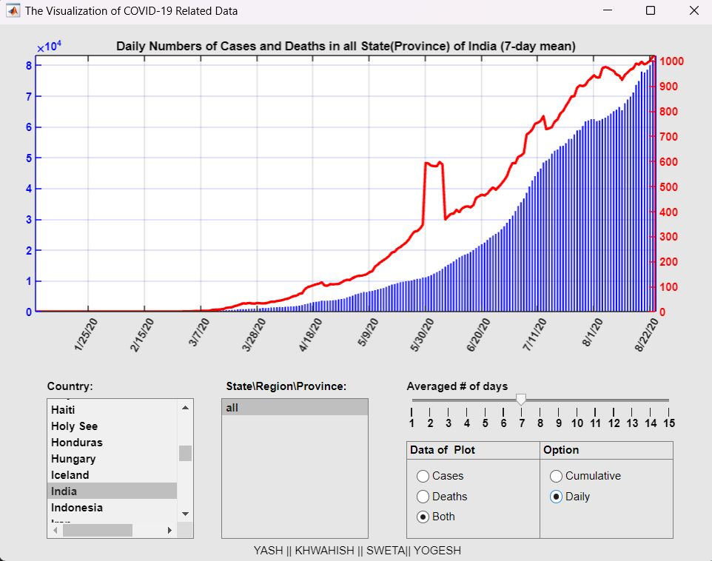
Results and Outputs

Slide 27
Conclusion
We outline the system design and estimating techniques for COVID-19-DATA-ANALYSIS-AND-VISUALIZATION in this project, which employs open surveys to track the spread of the COVID-19 pandemic. Our graphical estimates, which offer an estimated of the cumulative and active number of cases in various geographic locations, need a significant amount of data from active participants yet offer meaningful depictions of the pandemic's progression in various places.
The most important challenge and limitation of Corona Surveys is the volume of survey responses is Corona Surveys' most significant obstacle and restriction. In this regard, it's crucial to share our graphical estimates to retain and engage users as much as possible. To facilitate the spread of our graphical visualisations and hence boost user recruitment, we intend to incorporate a projection of the number of cases and fatalities based on recent data for various geographic locations in the future.
Our heuristic outlier identification techniques are also susceptible to future advancements that could make them more resistant to malevolent reactions. As Corona Surveys develops, elements like the number of responses each day may be added to help identify specific malicious attacks that open internet surveys may be vulnerable to.
Although more comparisons in various countries are needed, our initial analysis, which compared the findings of Corona Surveys with a serology investigation in Spain, produced outstanding results and supported open surveys and indirect reporting as possible sources of information to follow pandemics. Considering the "wisdom of the crowd" phenomenon, it would be interesting to discuss the minimum number of responses needed to generate estimates that are reasonably accurate. As the number of responses rises, individual errors in over- or underestimation are balanced out, and our outlier detection methods function better. The minimum number of responses will inevitably depend on factors like population dispersal and cultural influences on behaviour, however our initial estimation is that by indirectly giving data for a portion of the population equivalent to that of a massive serology study, we can already provide valuable estimates.
In conclusion, massive serology testing is ultimately the standard to accurately estimate the prevalence of COVID-19 in a region. However, this has its limitations, since it requires time until deployment, involves massive resources, and is unfeasible in some scenarios and countries. As an example, in the current outbreak in India as of April 2021, the level of underreporting is likely to be very which matches what is observe in the outputs. In these scenarios, we believe indirect reporting can provide a viable alternative to obtain early approximations of prevalence. Although Corona Surveys is a work in progress and much fine tuning is still required, we believe it provides a proof of concept of indirect reporting, as well as early results on its feasibility.

Slide 28
Future Scope
To learn more about other attributes such as patient gender, ethnicity and age and how it causes the fatality rate
A dashboard of interactive charts to provide an overall summary.
It helps to predict the upcoming waves of covid 19.
Provides a proper platform to track the covid 19 cases and death.

Slide 29
References
Centers for Disease Control and Prevention (2021a). Covid-19 Pandemic Planning Scenarios. Available at: https://www.cdc.gov/coronavirus/2019-ncov/hcp/planning-scenarios.html (Accessed December 12, 2020).
Google Scholar
Centers for Disease Control and Prevention (2021b). Clinical Questions about Covid-19: Questions and Answers. Available at: https://www.cdc.gov/coronavirus/2019-ncov/hcp/faq.html (Accessed 05 09, 2021).
Google Scholar
Fan, J., Yao, L., Stewart, K., Kommareddy, A. R., Bradford, A., Chiu, S., et al. (2020). Covid-19 World Symptom Survey Data Api. Available at: https://covidmap.umd.edu/api.html (Accessed May 28, 2021).
Google Scholar
García-Agundez, A., Ojo, O., Hernández-Roig, H. A., Baquero, C., Frey, D., Georgiou, C., et al. (2021). Estimating the COVID-19 Prevalence in spain with Indirect Reporting via Open Surveys. Front. Public Health 9. Available at: https://www.medrxiv.org/content/10.1101/2021.01.29.20248125v1 (Accessed May 28, 2021).
https://www.kaggle.com/datasets/imdevskp/corona-virus-report
https://in.mathworks.com/help/thingspeak/visualize-data.html

